Slide 1
Ascension Technology
C.A.R.
Matthew Darby, Maggie Burton, Weston Straw, Mark Du, Andrew Case, Stevie Damrel

Slide 2
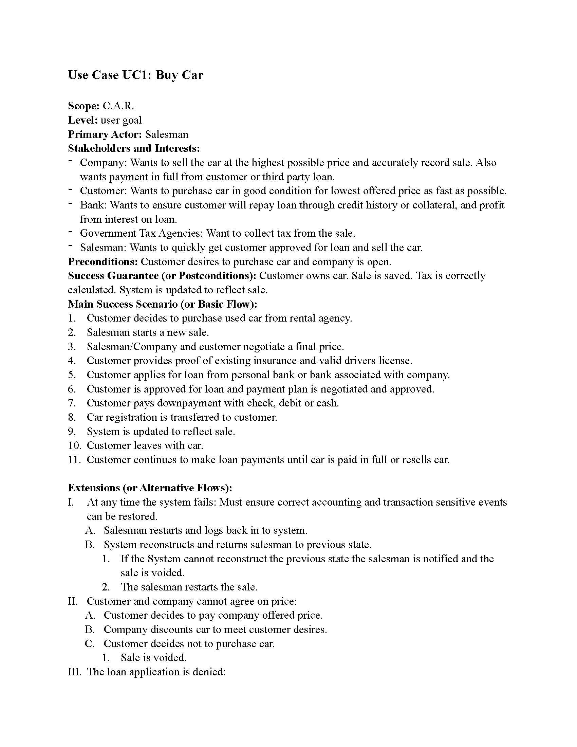

Slide 3
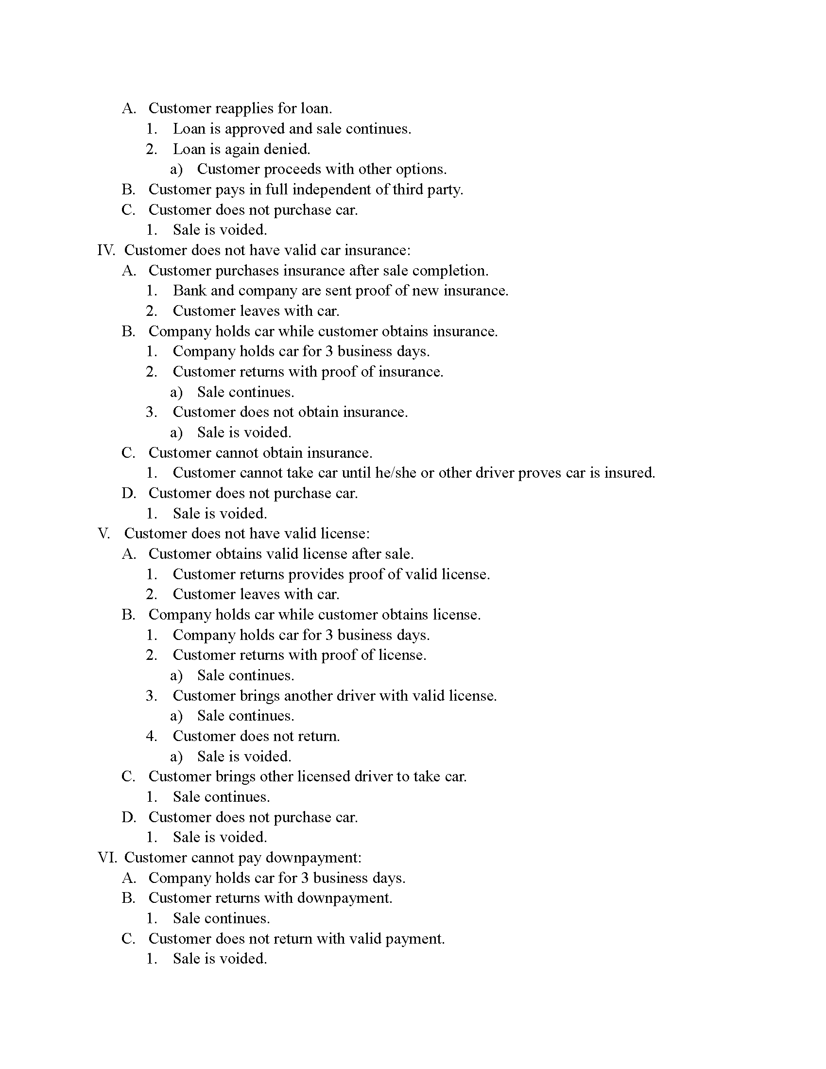

Slide 4
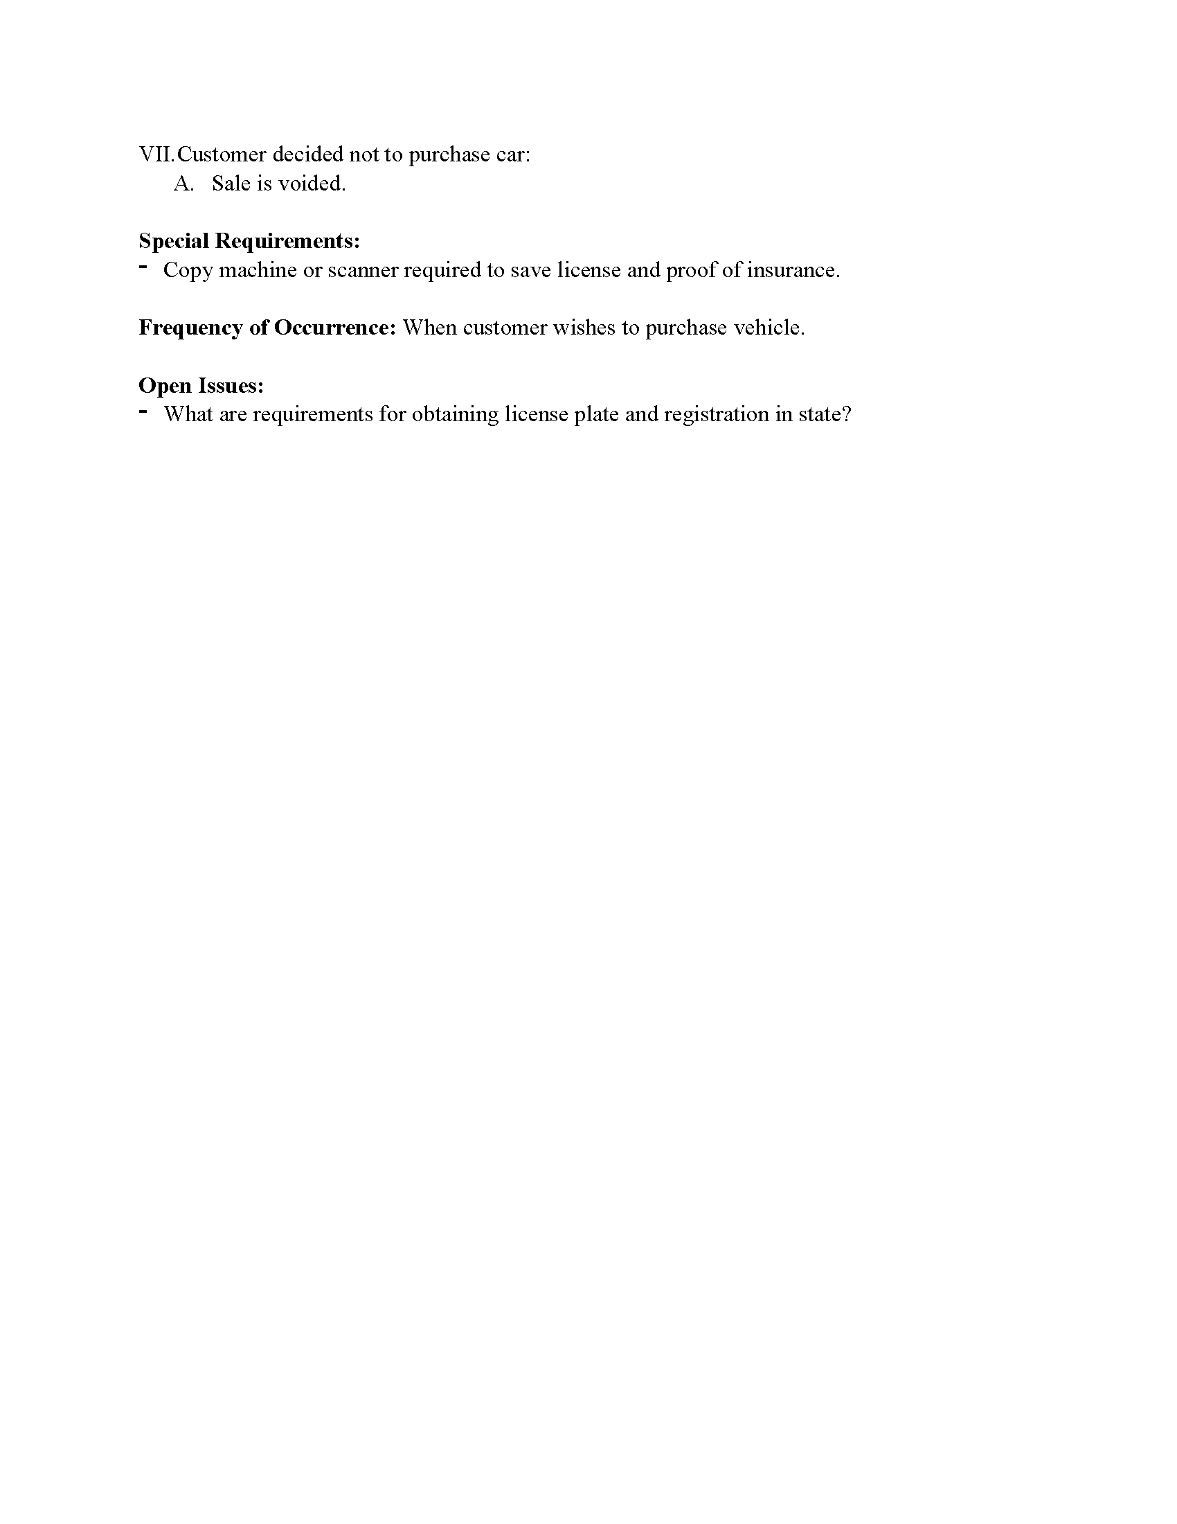

Slide 5
Text about domain model

Slide 7
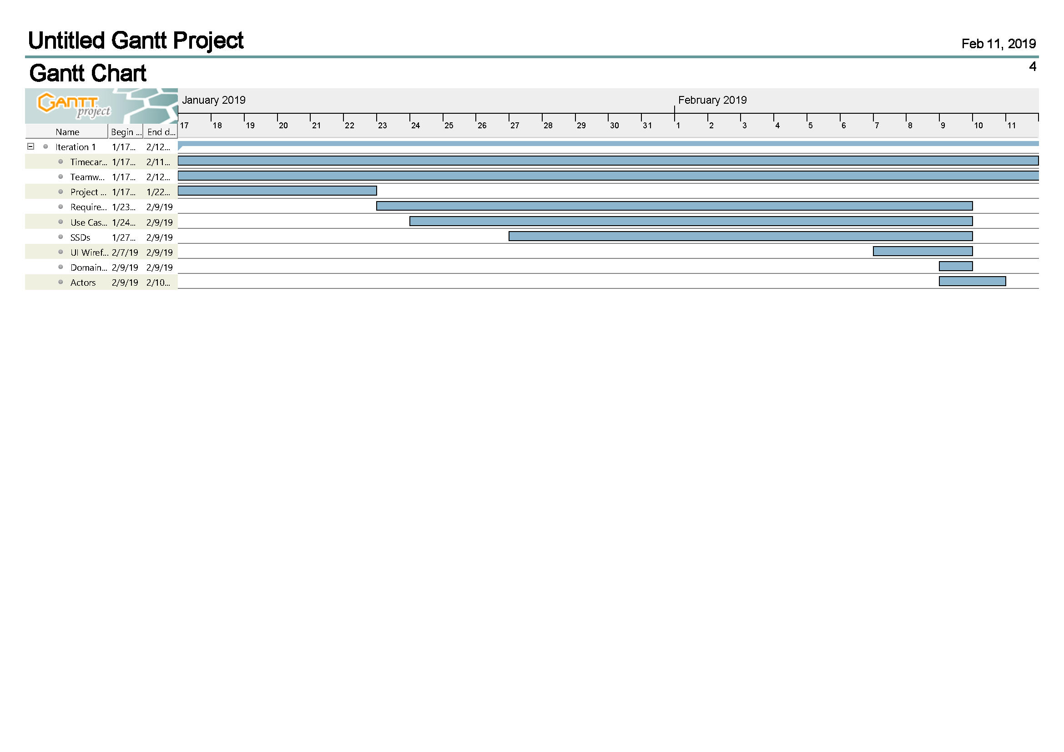
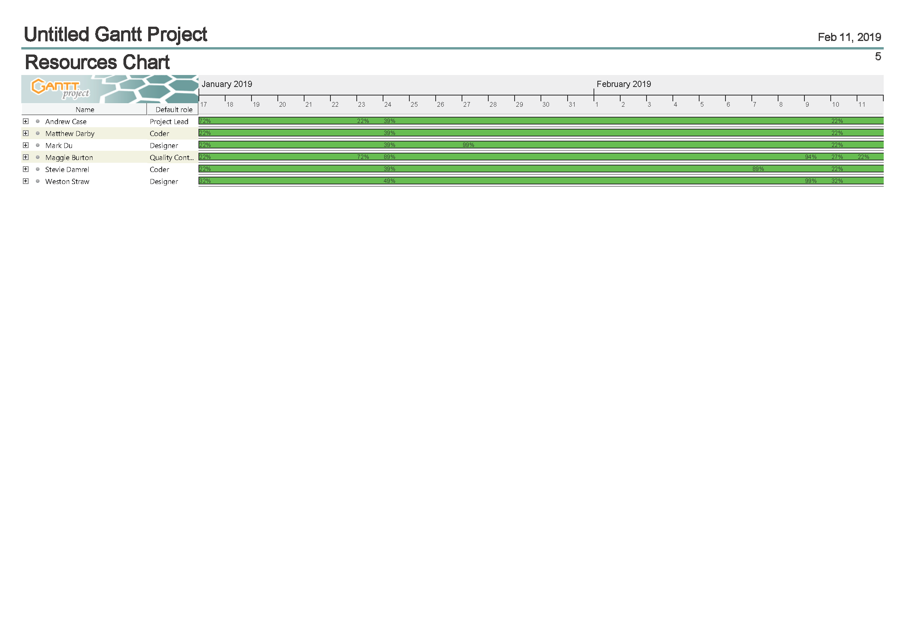

Slide 8
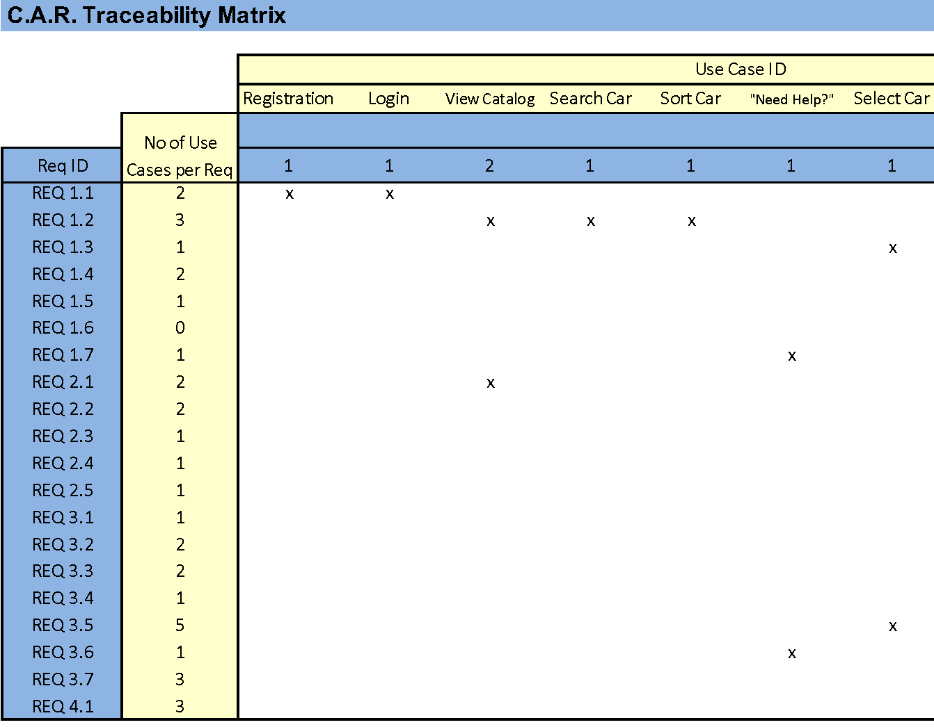
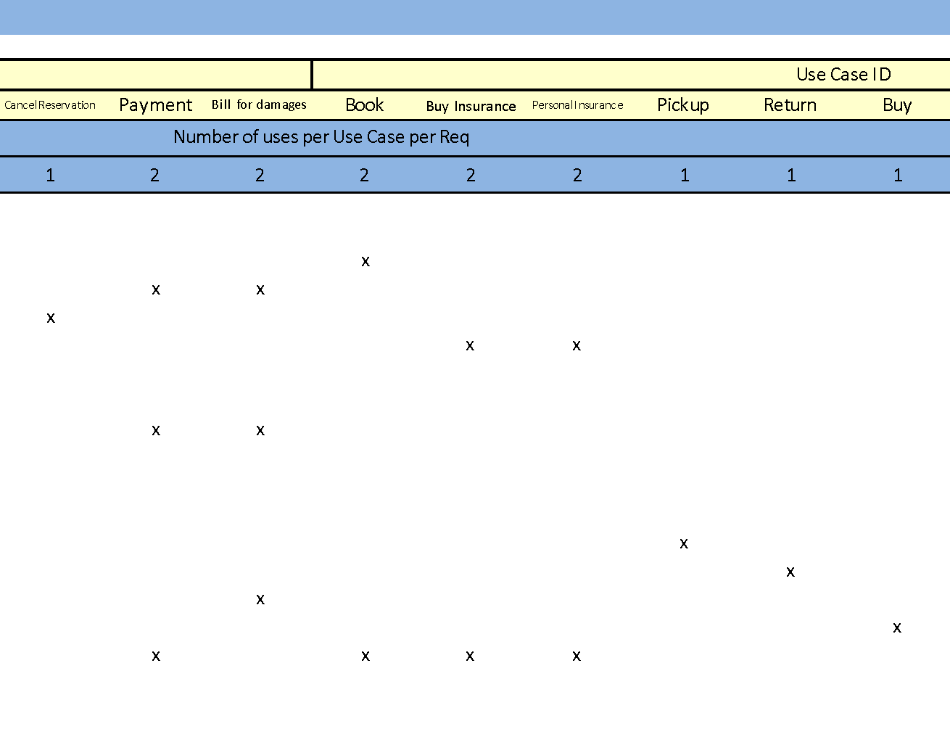
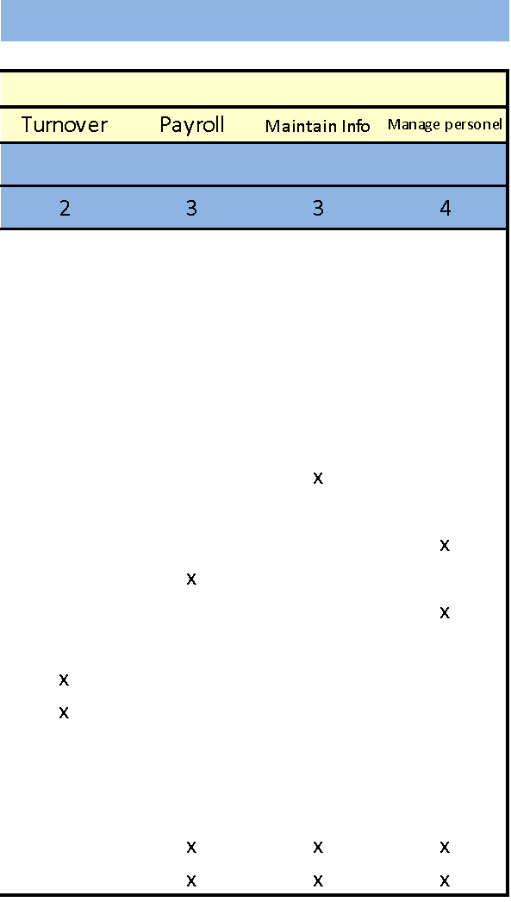

Slide 9
wireframe

